Slide 1
Simulation: Memory Allocation Methods Comparison

Slide 2
Approach
Programming language: Java
Pages are simulated using an array
arrMemory[# of pages][2]
arrMemory[# of pages][0] = size of space
arrMemory[# of pages][1] = finishing time
Processes are simulated using an array
arrProcess[# of processes][3]
arrProcess[# of processes][0] = arrival time
arrProcess[# of processes][1] = size of space
arrProcess[# of processes][2] = finishing time
int timer is used for simulating the time

Slide 3
OS 8MB
2MB
2MB
OS 8MB
4MB
8MB
4MB
8MB
4MB
Simulation: Fixed Partition with Equal Size (FE)
Simulation: Fixed Partition with Unequal Size (FU)
8MB
4MB
8MB
6MB
8MB
6MB
8MB
8MB
8MB
8MB
8MB

Slide 4
Dynamic Partition with First Fit (DFF)
After Compaction
OS 8MB
OS 8MB
OS 8MB
OS 8MB
P1
P1
P1
P1
P2
P4
Invisible Frames: the issue we fixed
P3
P4
P4
P4
Invisible Frames are merged
After compaction, a larger space will be available

Slide 5
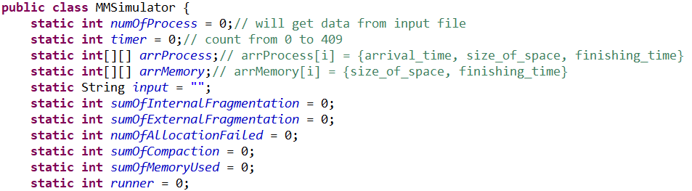

Slide 6
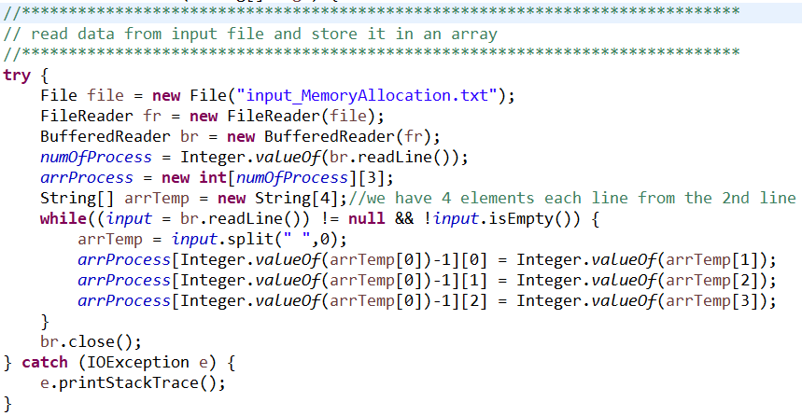

Slide 7
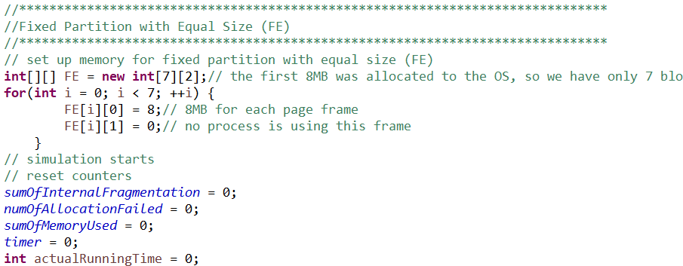

Slide 8
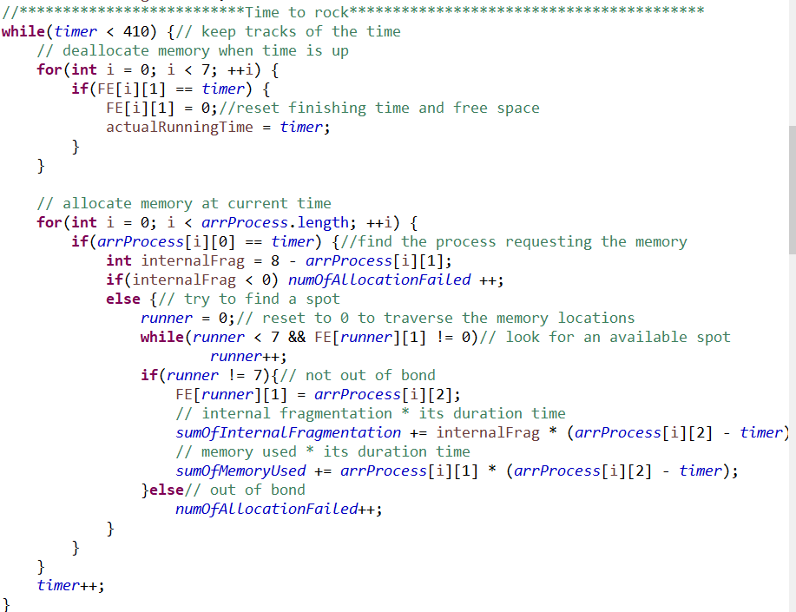

Slide 9
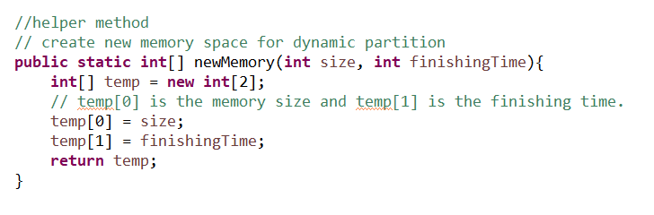

Slide 10
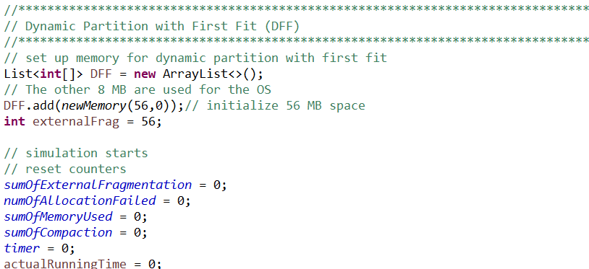

Slide 11
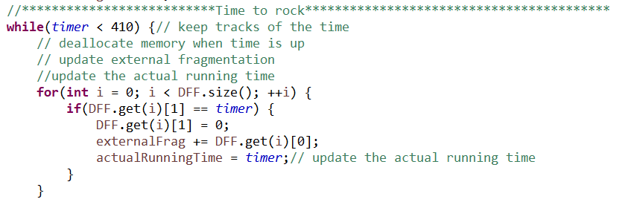

Slide 12
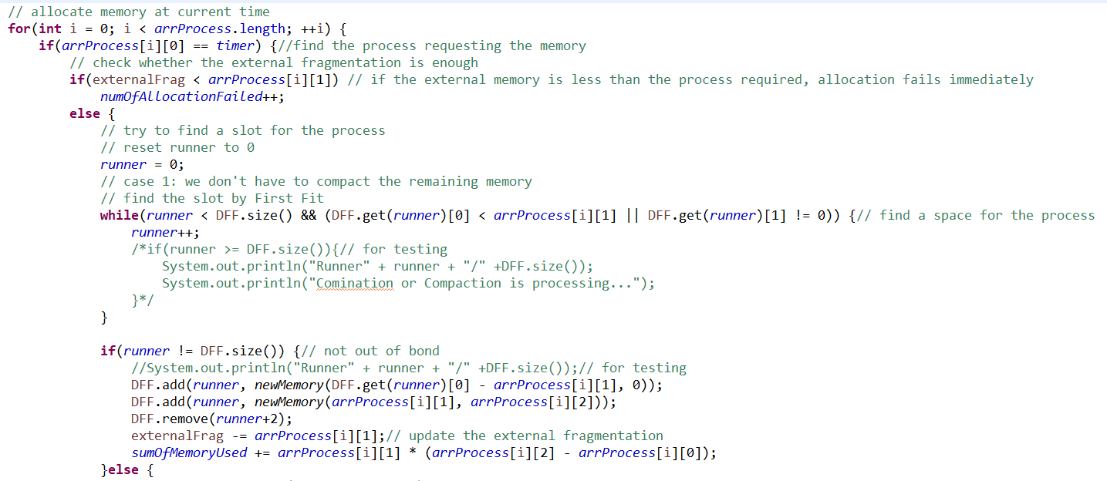

Slide 13
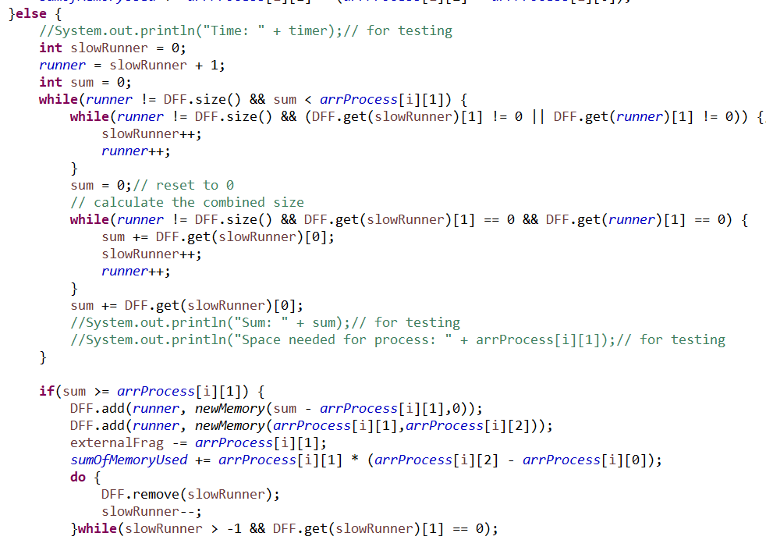

Slide 14
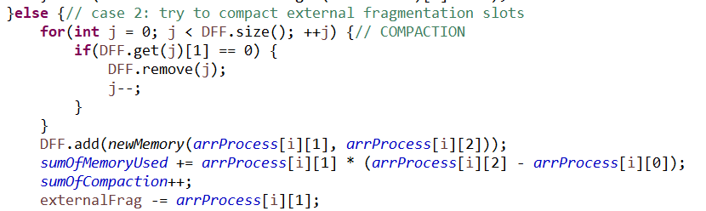

Slide 15
Results(updated)
Fixed Partition with Equal Size (FE):
Average Internal Fragmentation is 12
Average External Fragmentation is 26
The Number of allocation fails is 29
Memory Utilization is 40.77%
Fixed Partition with Uequal Size (FU):
Average Internal Fragmentation is 6
Average External Fragmentation is 26
The Number of allocation fails is 22
Memory Utilization is 50.47%
Dynamic Partition with First Fit (DFF):
Average External Fragmentation is 33
The Number of Compaction for Dynamic Partition is 3
The Number of Allocation fails is 18
Memory Utilization is 47.61%

Slide 16
Analysis:
Comparison between the Fixed Partition with Equal Size (FE) and the Fixed Partition with Unequal Size (FU)
The major difference between FE and FU is how to determine the page size of the memory. The page size is unique in FE which may lead to a mismatch between page size and the memory space that a process needs. To improve the the memory utilization, the unequal size partition technique was introduced, but still could not resolve the mismatch problem completely.
From the results, it can be seen that the average internal fragmentation in FU is much smaller than the one in FE compared to their relatively small sizes. Also, the number of allocation failed in FE is more than the one in FU. The memory utilization performs better in FU. It can be concluded that FU is a better partition method over FE.

Slide 17
Analysis:
Comparison between the Fixed Partition with Unequal Size (FU) and the Dynamic Partition with First Fit (DFF)
Our major attention is the average external fragmentation in our DFF. There is an average of 33 MB external fragmentation which can satisfy any process with the required memory no greater than 8MB. Therefore, the compaction will be triggered when there is enough external fragmentation. After examined the provided data set, we realized that the processes did not come into the memory continuously. During that time, part of the memory was probably idle leading to a large external fragmentation. Also, there was a flaw in designing the algorithm of dynamic partition, but has been resolved later. In the previous design, the external fragmentation has “invisible frames”. As a process traverses the memory for a suitable position, the space containing two consecutive empty “frames” will not be treated as one integrated space. This may cause more compactions. This issue was resolved by combining these “frames” before searching for a location.
However, the DFF method has the best performance in less allocation failures and relatively higher memory utilization. The average external fragmentation is expected to be less than 8 MB but results in 33 MB due to partially idling of the memory.
The major disadvantage of DFF is that it requires reallocations and compactions and may leave in the memory with many small external fragmentations between processes which causes more compactions.

